Slide 1
Intro to eXist-db and Applet XQuery
Angelo Mario Del Grosso (ILC-CNR, Pisa) angelomario.delgrosso@cnr.it
FeDHLab

Slide 2

Seminar Outline
Intro to eXist-db
Intro to XML-based languages
XPath
XQuery
XSL-T
Intro to Web Applet with HTML templating package
General Architecture
File Scaffolding with YEOMAN
Applet Structure and Main Resources
Step-by-Step Demo Web Applet Implementation
Final Review of the Web Applet
eXist-db Web Applet Examples

Slide 3
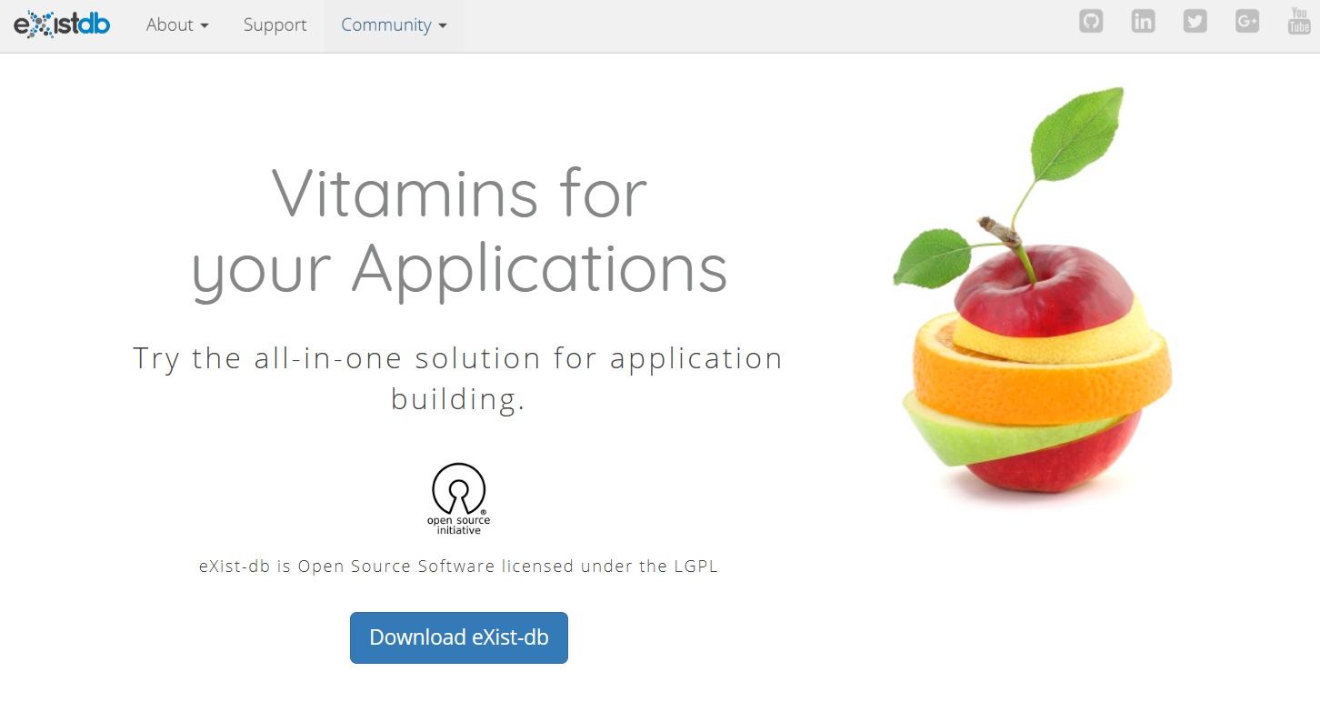
eXist-db (http://exist-db.org/)

Slide 4
eXist-db: What is
eXist is an open source piece of software written in Java that is freely available in both source code and binary form
• A NoSQL document database for XML and binary (including text)
• A web server for consuming and serving documents
• A document search engine
• A web application platform
• An Integration platform
• An embeddable set of libraries for use in your own applications

Slide 5
Important Feature
eXist makes use of a standardized query language developed by the
W3C: XML Query Language (XQuery)
XQuery is also a functional programming, designed primarily as a query
language but in eXist you can build entire applications in just XQuery

Slide 6
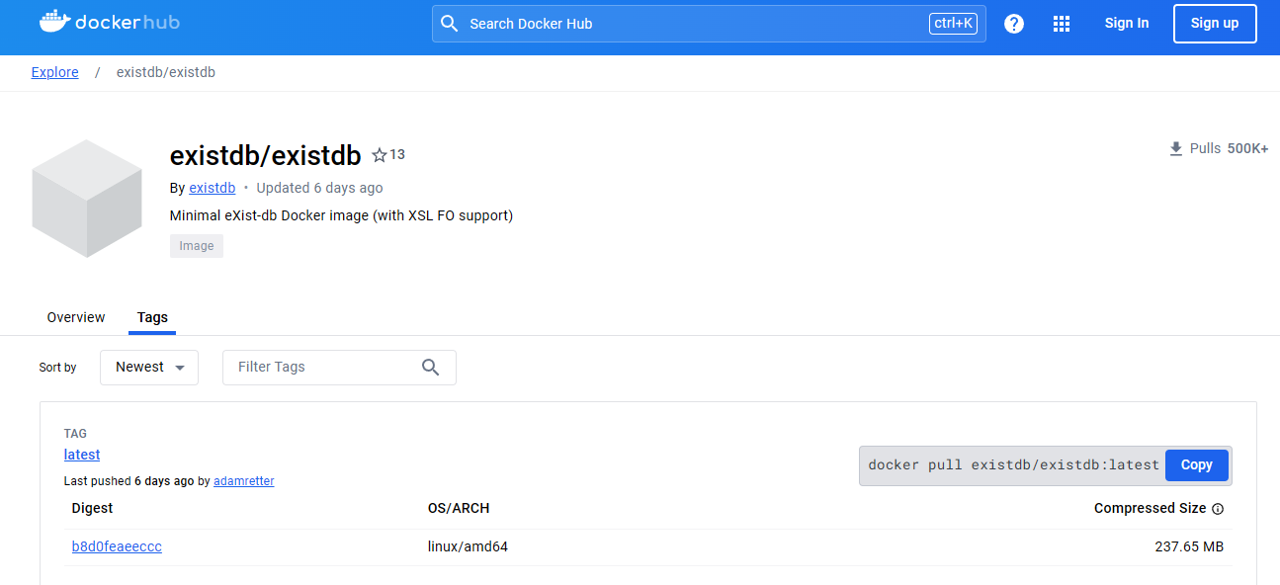
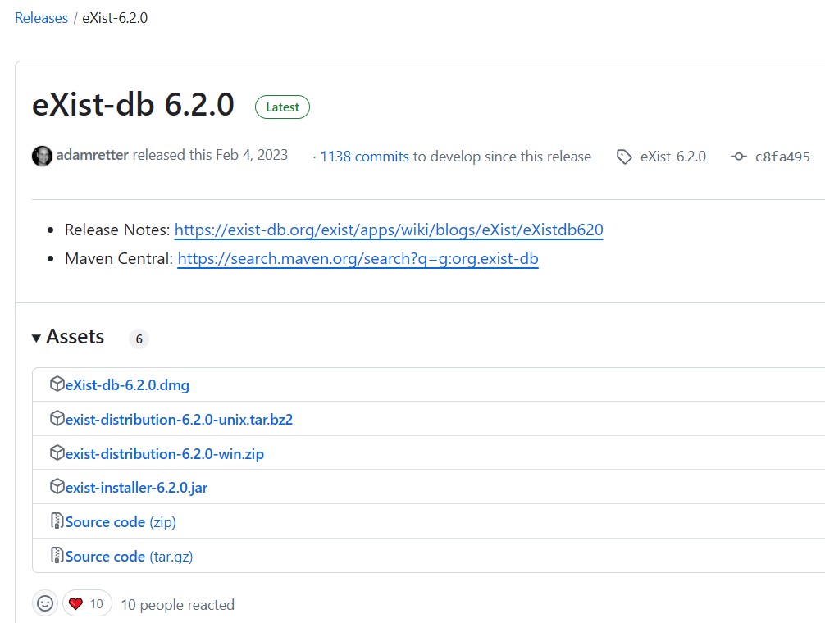
Installing eXist-db
services:
exist:
image: existdb/existdb:release
container_name: exist-studenti
ports:
- 48002:8080
- 48004:8443

Slide 7
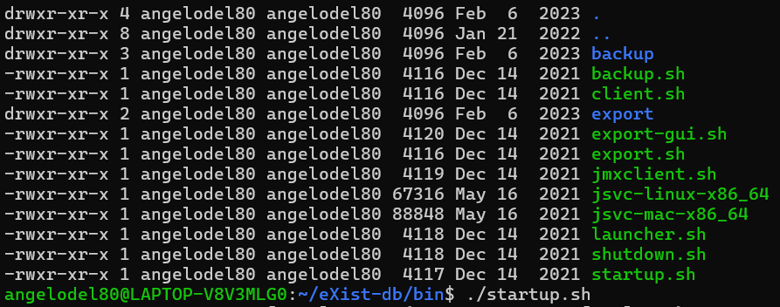
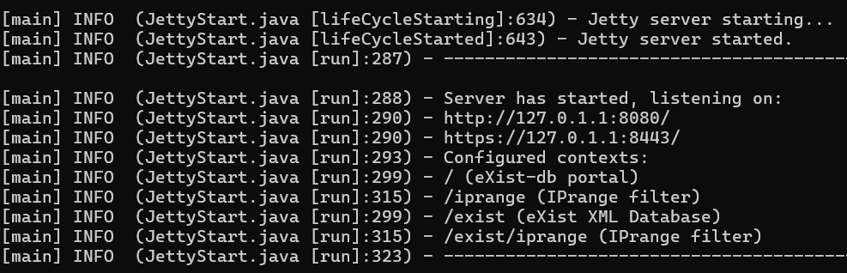
Running eXist - db

Slide 8
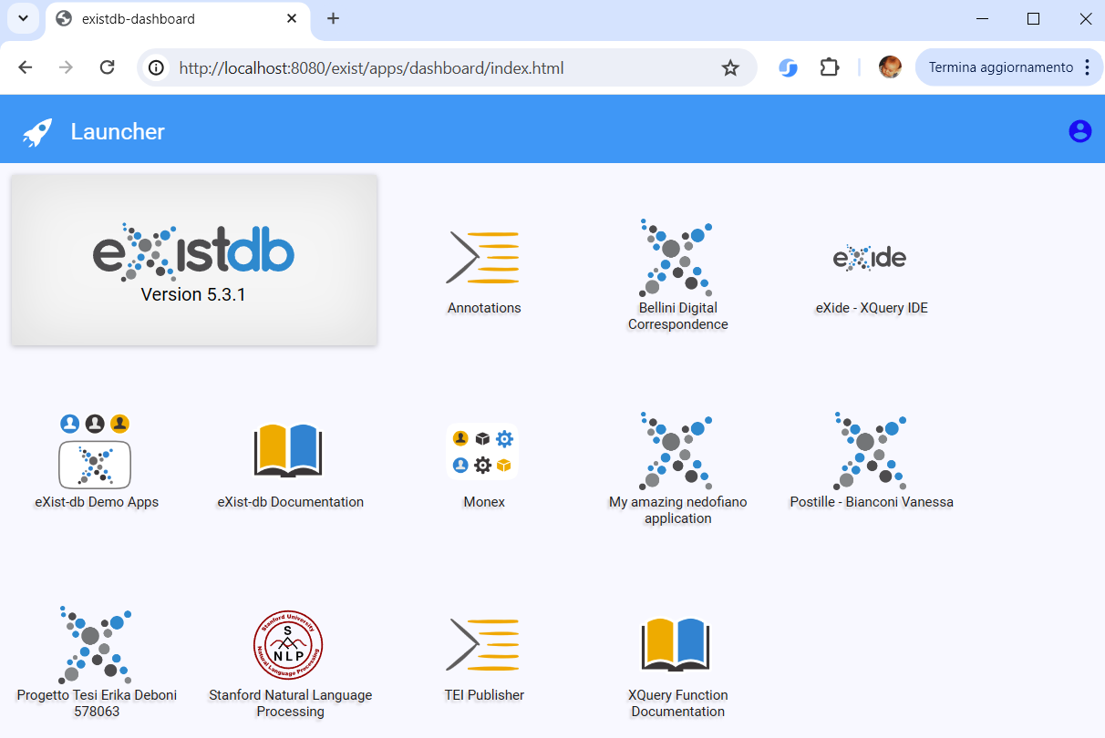
Dashboard

Slide 9
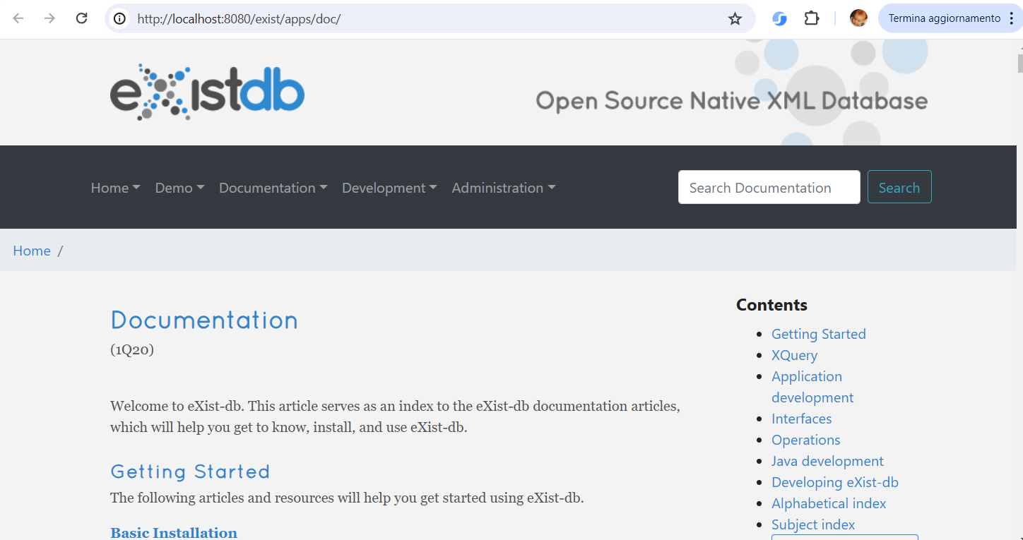
Documentation

Slide 10
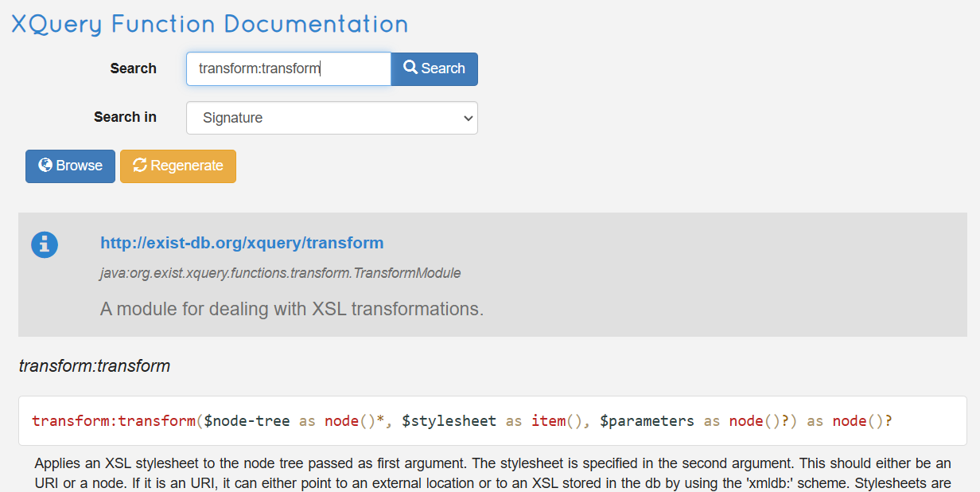
Standard and Third Party Functions

Slide 11
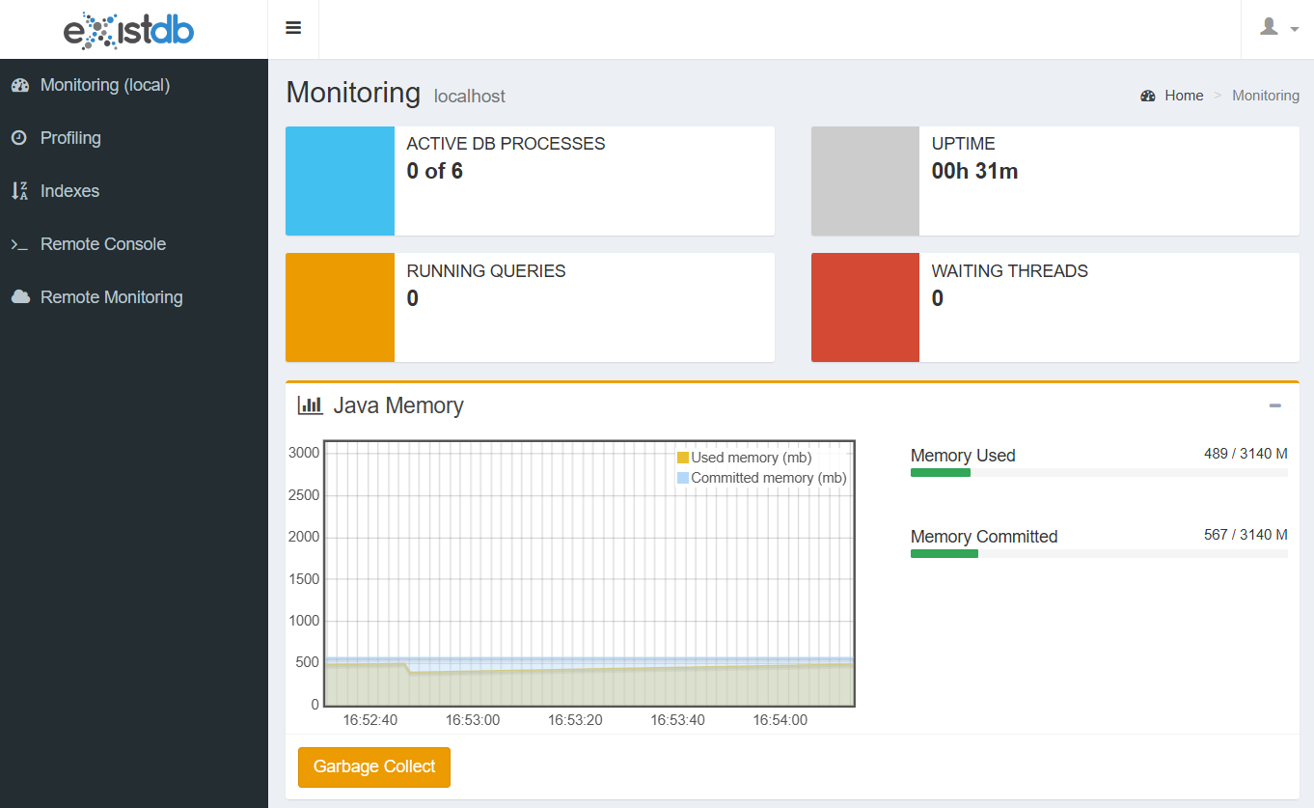
Monitoring (Monex)

Slide 12
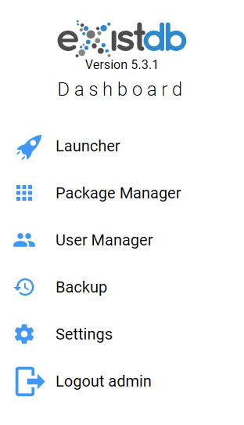
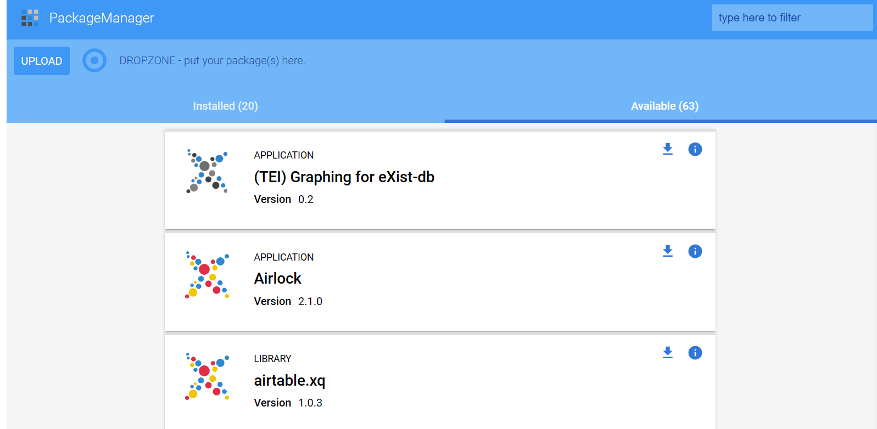
Admin Features

Slide 13
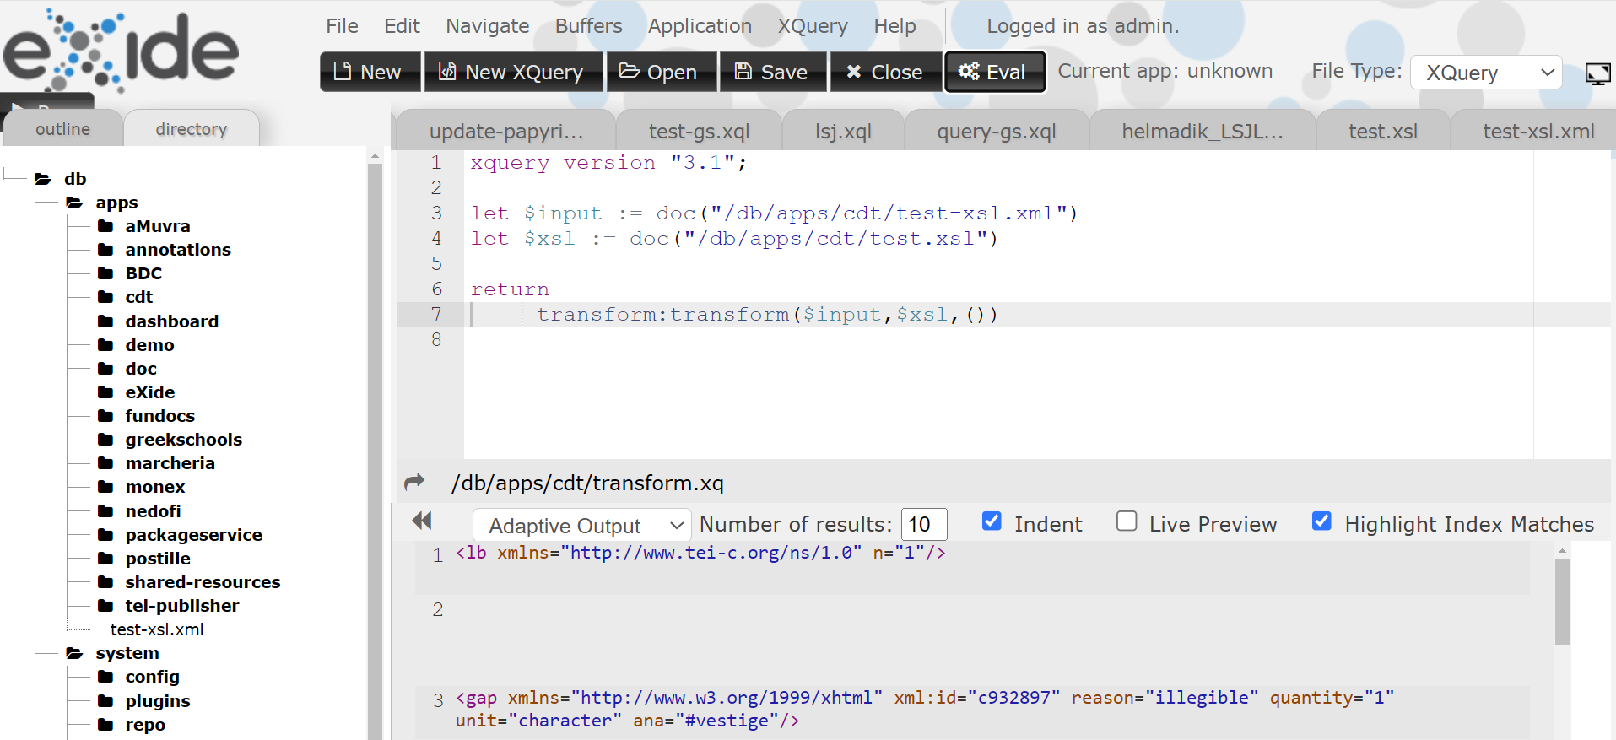
eXide - XQuery Integrated development environment

Slide 14

Main XML-based Languages
XPath: expression language to select nodes from an XML document
XQuery: powerful language designed to query and manipulate XML data
XSLT: flexible language used to manipulate and transform XML documents

Slide 15
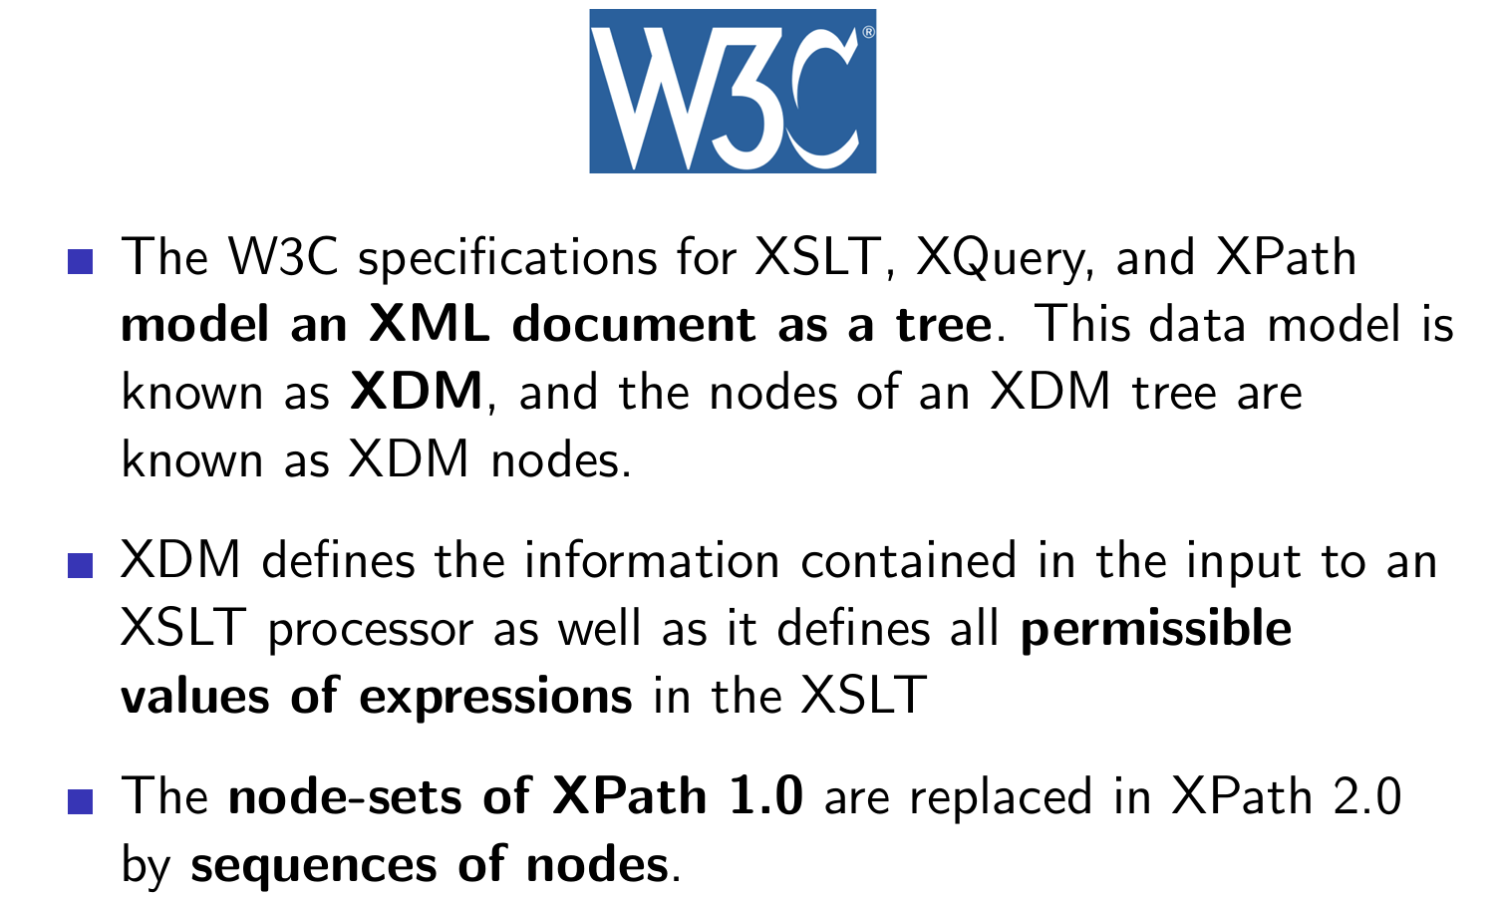

Slide 16
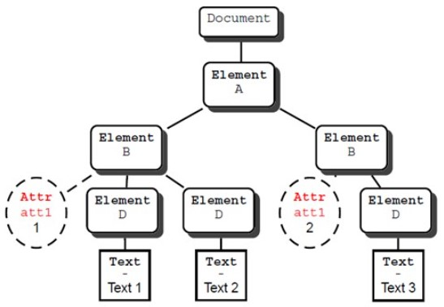
XDM - Tree Model

Slide 17
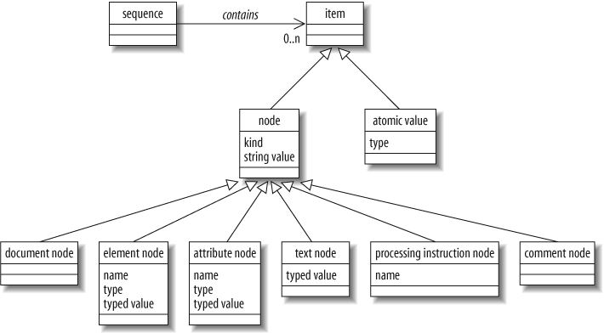
XDM Data Model

Slide 18
XPath
XPath is an expression language to select nodes from an XML document
It is used to traverse elements and attributes in an XML tree
It is embeddable in XSLT, XQuery and many other programming or scripting languages
It is based on axes to establish the relations among nodes (e.g. child, sibling, parent, ancestor, etc.)

Slide 19
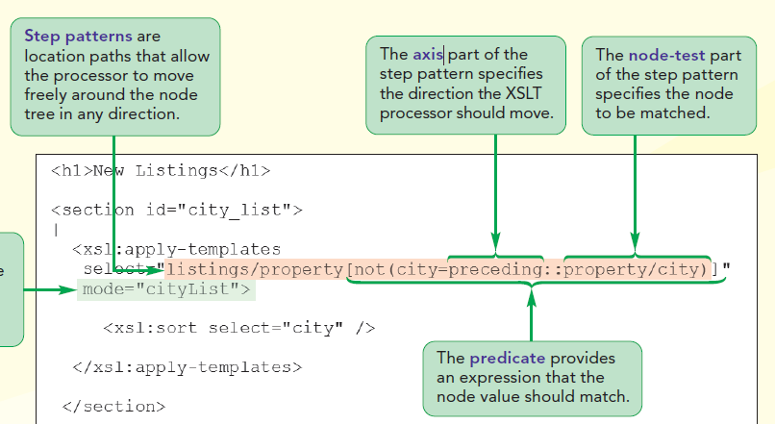
New Perspectives on XML, Patrick Carey, Sasha Vodnik, 2014

Slide 20
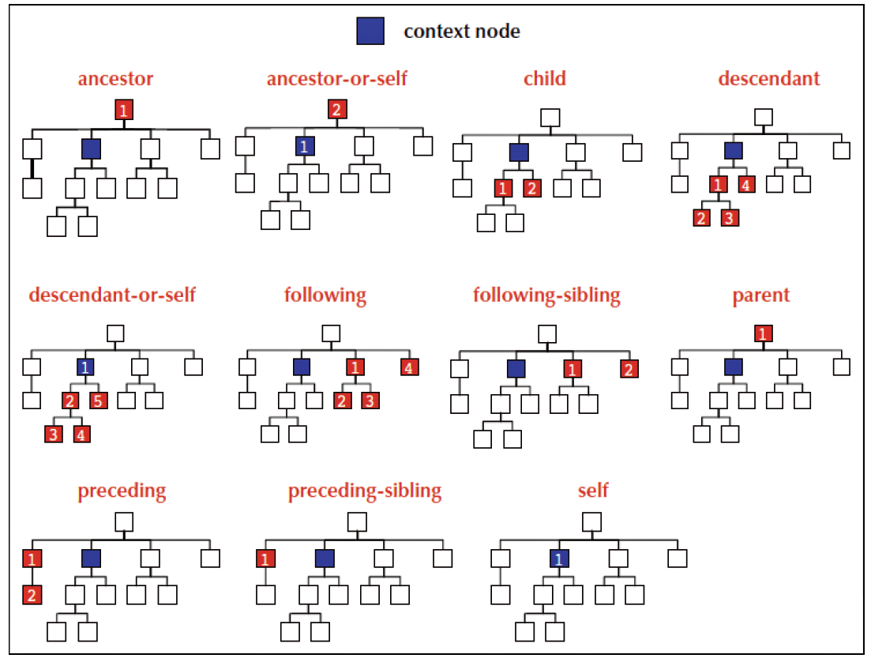
New Perspectives on XML, Patrick Carey, Sasha Vodnik, 2014

Slide 21
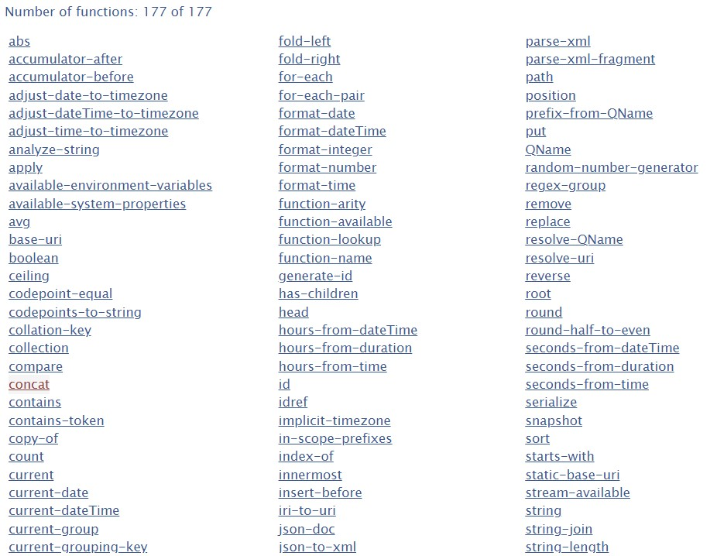

Slide 22
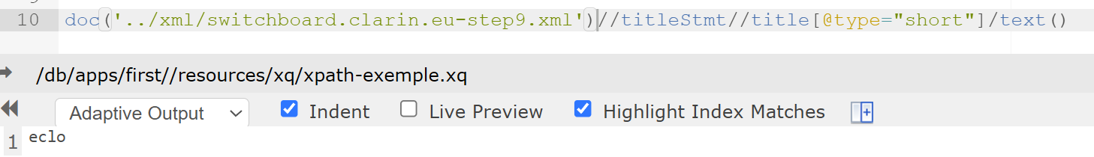
XPath example in eXide

Slide 23
XQuery
XQuery is a powerful query language designed to query and manipulate XML data
Compared to XSLT, XQuery is extremely compact and this aspect enhances the readability of the scripts

Slide 24
FLOWR syntax
XQuery is based on the FLWOR (For, Let, Where, Order-by, Return) construct. It is very compact and also students in traditional humanities can manage it

Slide 25
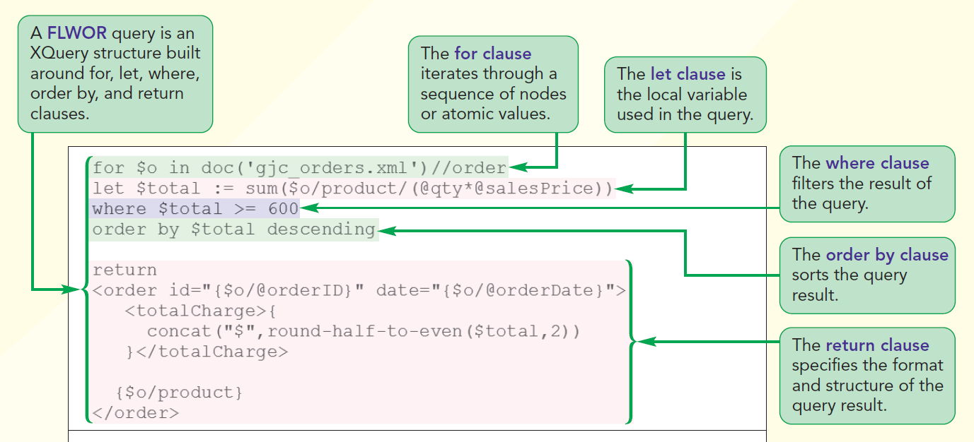
FLOWR syntax (cont.)

Slide 26
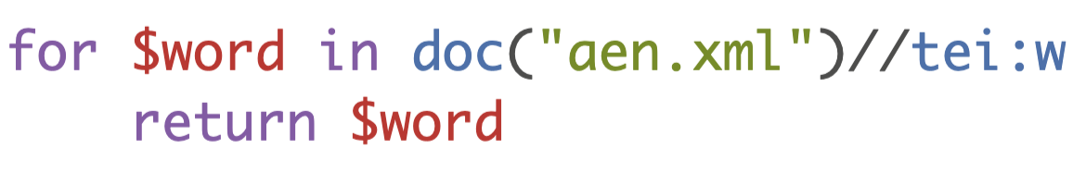
For clause
Purpose: Iterates over a sequence of items
Functionality: The For clause binds a variable to each item in a sequence, allowing for iteration over large datasets, much like a loop in other programming languages. It can iterate over nodes, values, or any sequence generated by an XQuery expression

Slide 27
Let clause
Purpose: Binds values to variables
Functionality: The Let clause is used to assign a value to a variable. Unlike the For clause, Let does not iterate but simply assigns a value to be used later in the FLWOR statement. It is useful for storing intermediate results

Slide 28

Where clause
Purpose: Filters data based on conditions
Functionality: The Where clause restricts the results returned by the FLWOR expression, acting as a filter that allows only items meeting certain conditions to be processed in the subsequent clauses

Slide 29
Order by clause
Purpose: Sorts the results of the query
Functionality: The Order by clause sorts the items returned by the query, based on specified criteria. This sorting can be done in ascending or descending order

Slide 30
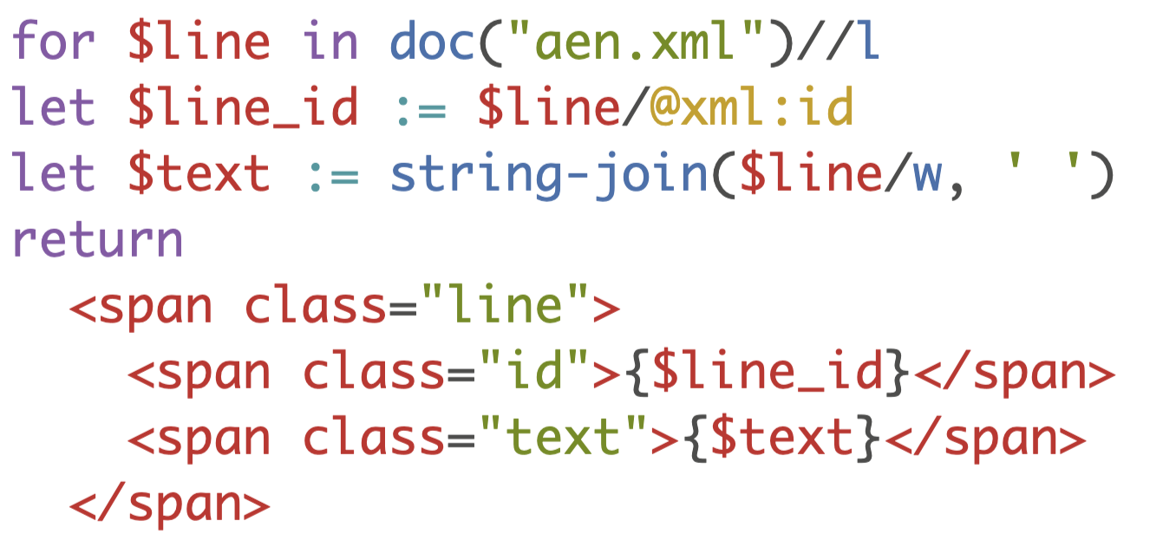
Return clause
Purpose: Specifies what is to be returned from the query
Functionality: The Return clause determines what will be included in the final output of the FLWOR statement. This can be a node, a constructed element, a value, or any combination of these

Slide 31
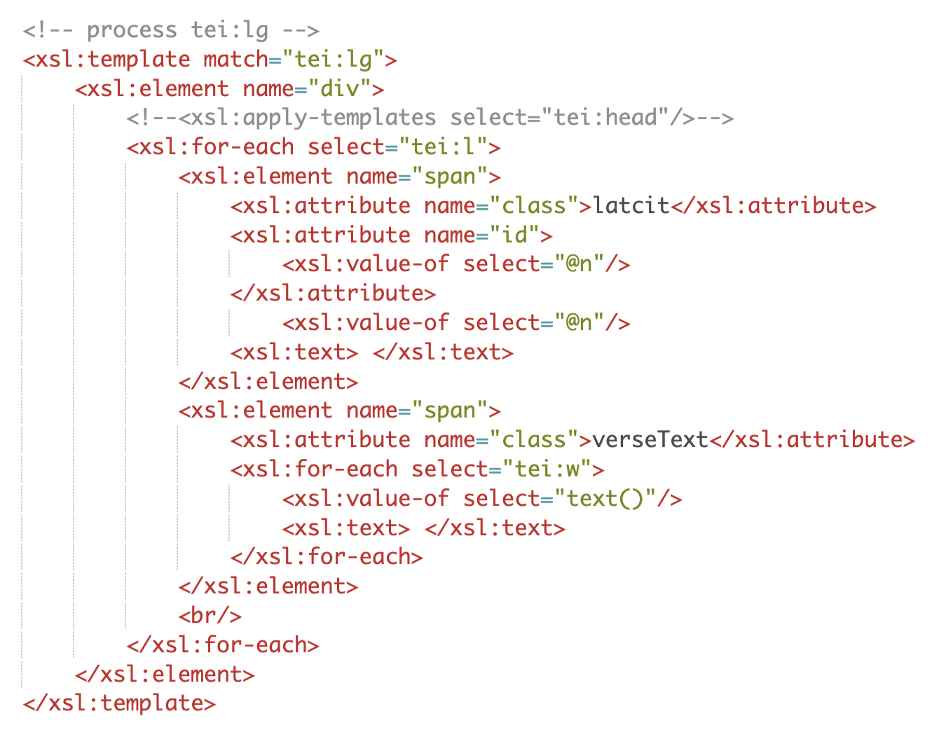
XSLT transformations from XQuery
XQuery can perform XSLT transformations, which are more familiar to the XML-TEI community than the xquery language

Slide 32
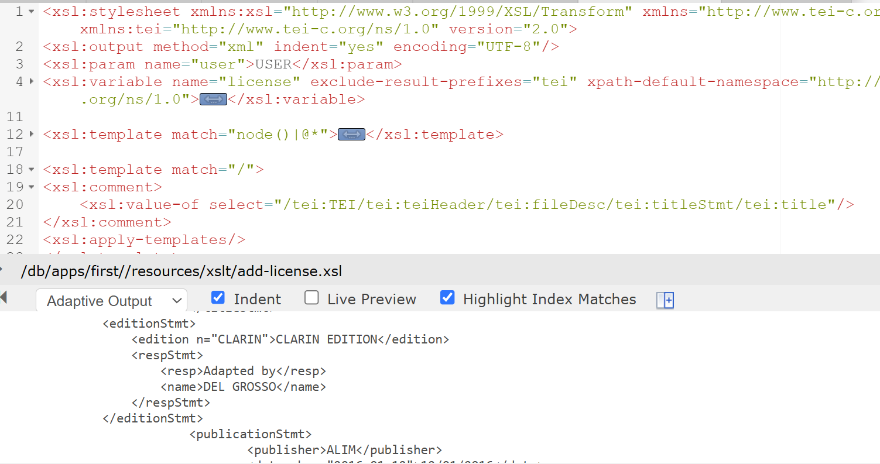
eXide - XSLT Example

Slide 33
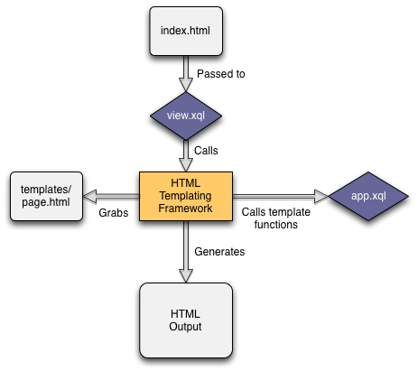
eXist-db HTML Templating Framework
Clean separation of concerns
Connect HTML views with the application logic
Call the HTML Templating for every URL ending with .html
XQuery function calls
Templating functions provided by the module

Slide 34
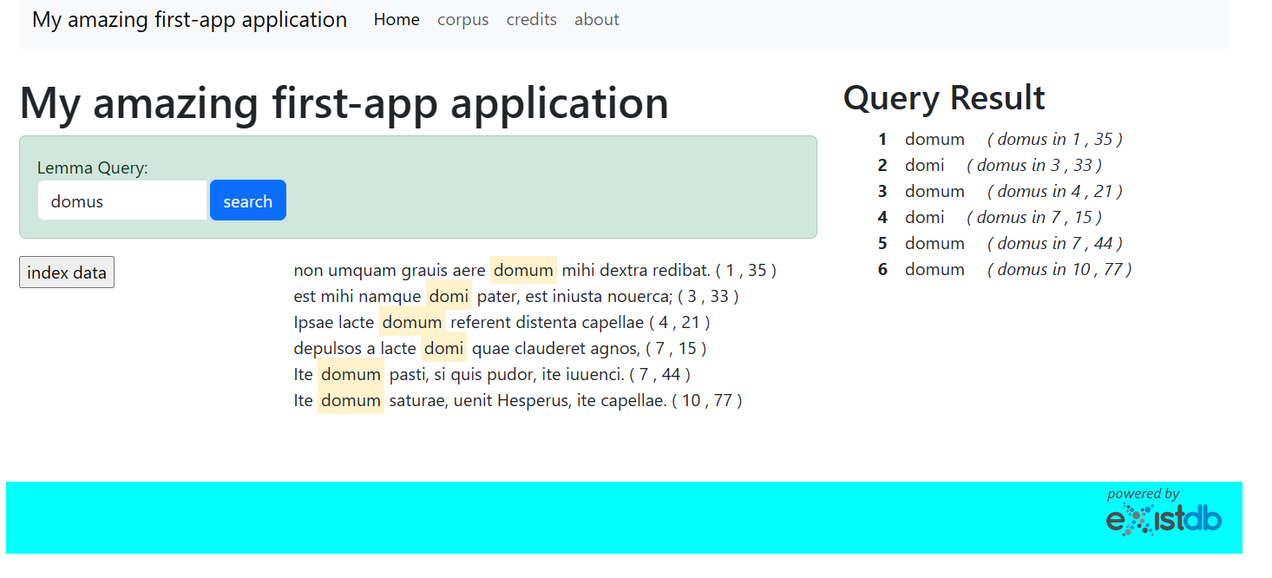
Demo Web Applet

Slide 35
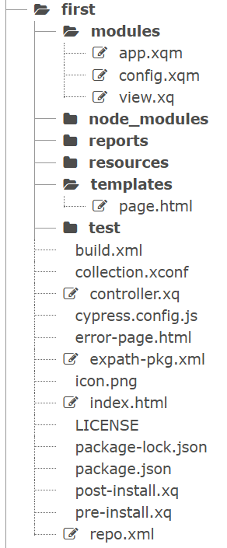
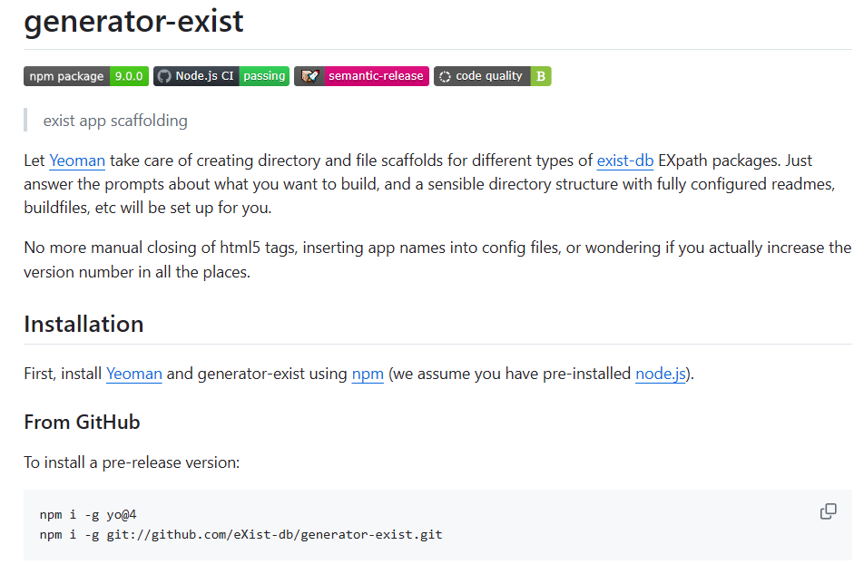
Folder and File Scaffolds using Yeoman

Slide 36
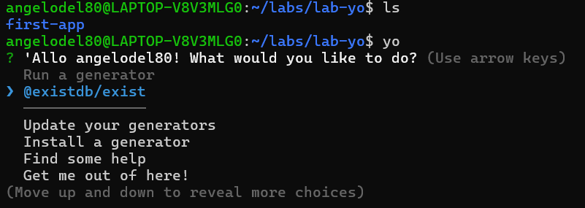
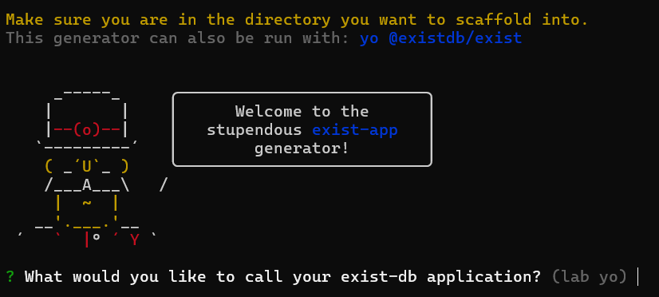
Folder and File Scaffolds using Yeoman

Slide 37
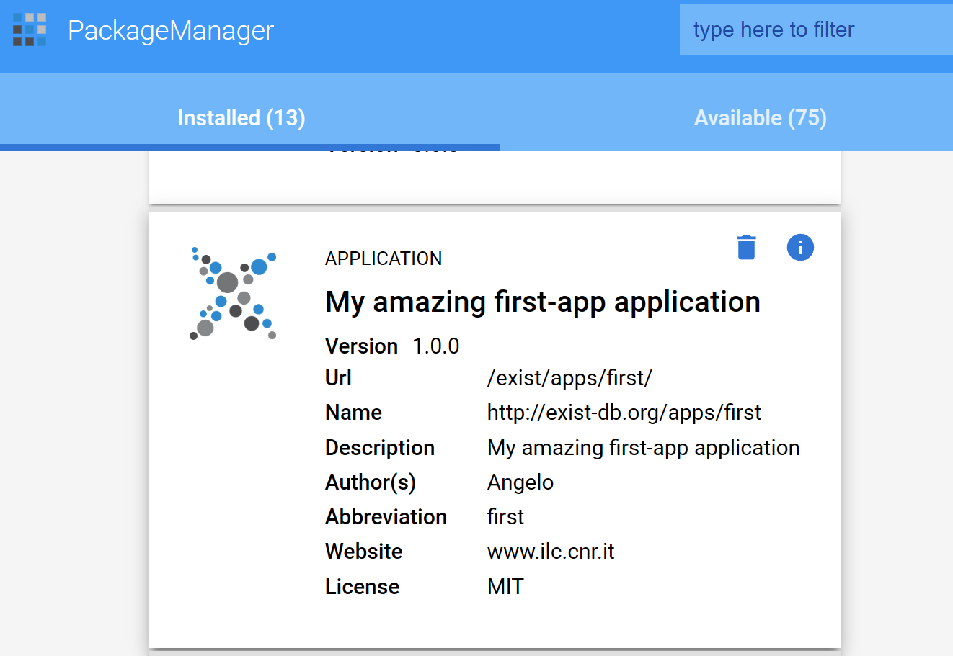
Upload the Scaffolding Application to eXist

Slide 38
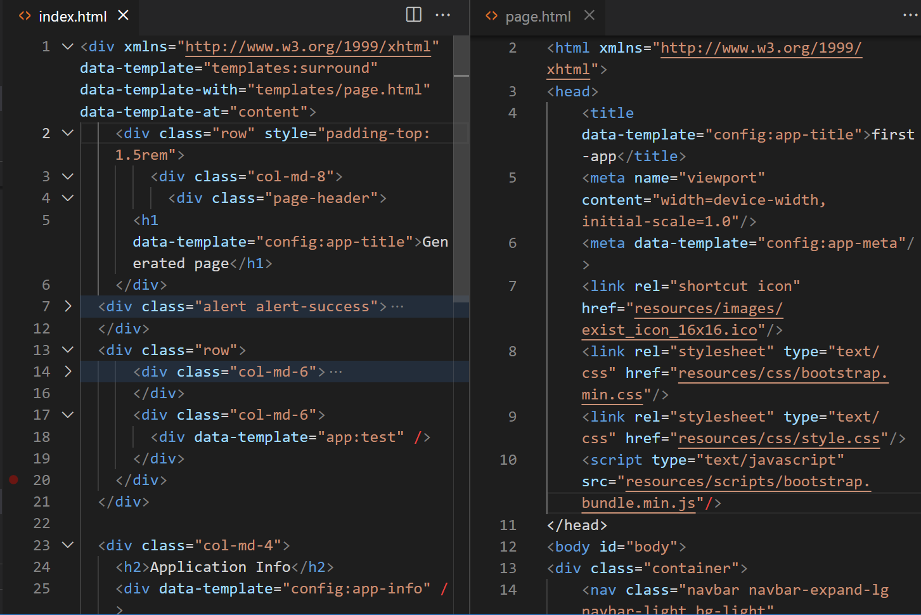

Slide 39
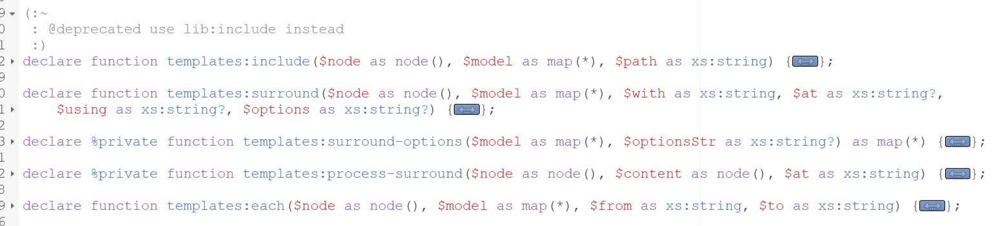
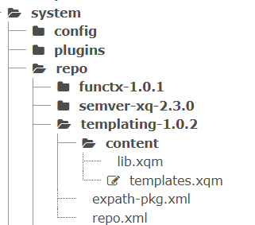
Templates Module

Slide 40
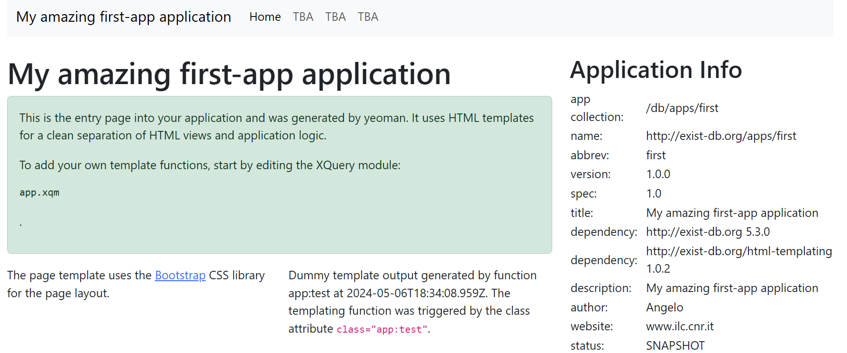
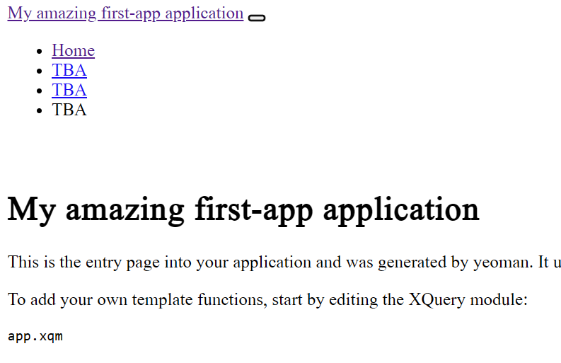

Slide 41
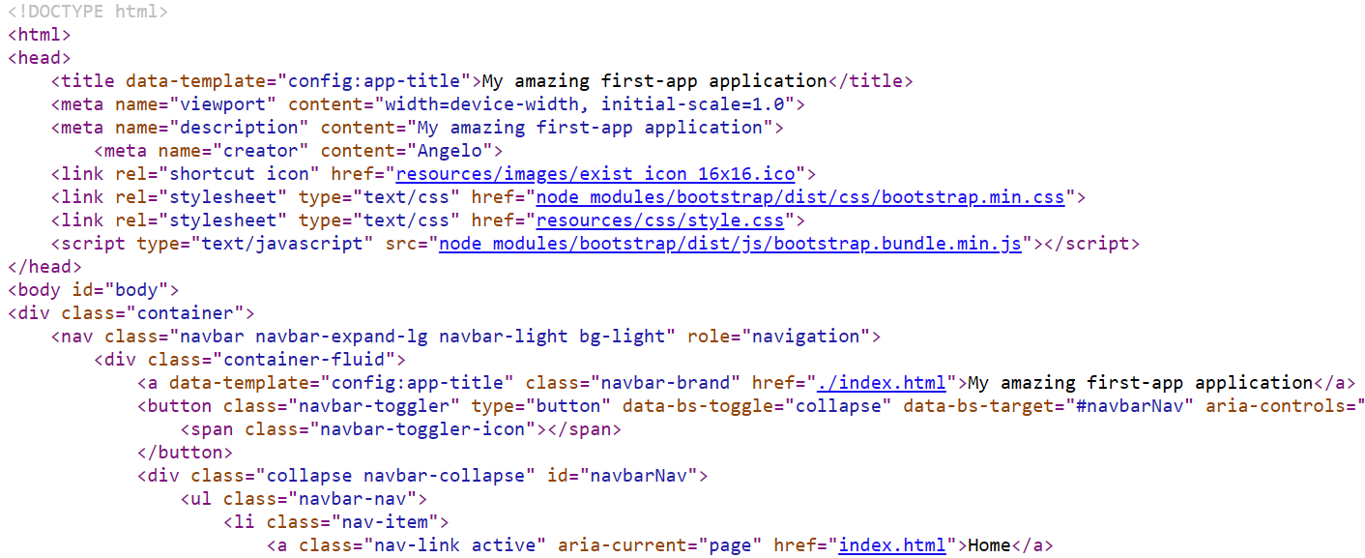
HTML of the Applet

Slide 42
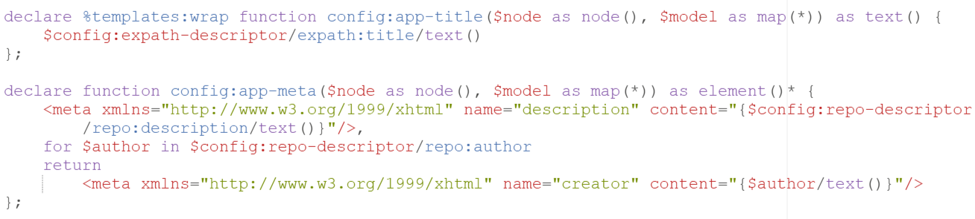
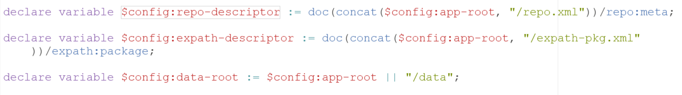
Confing Module Template (Config.xqm)

Slide 43
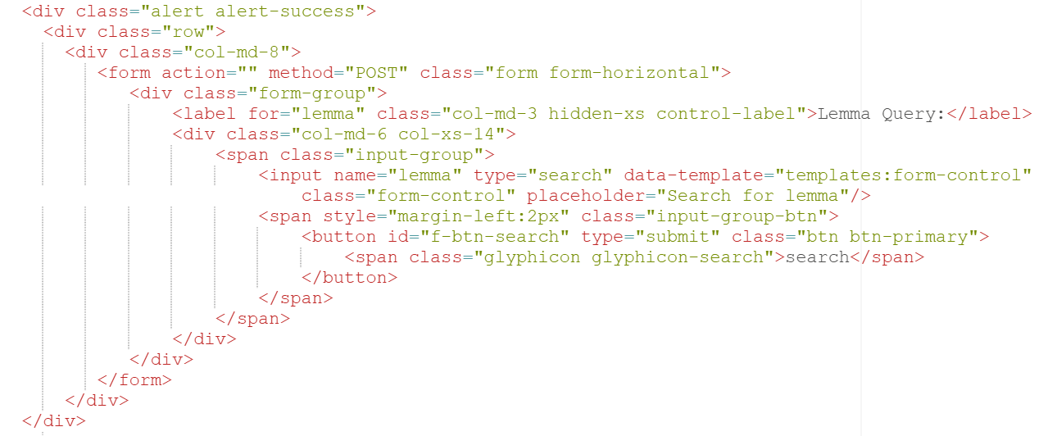
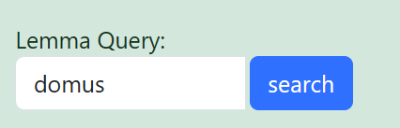
Input - Query Lemma

Slide 44
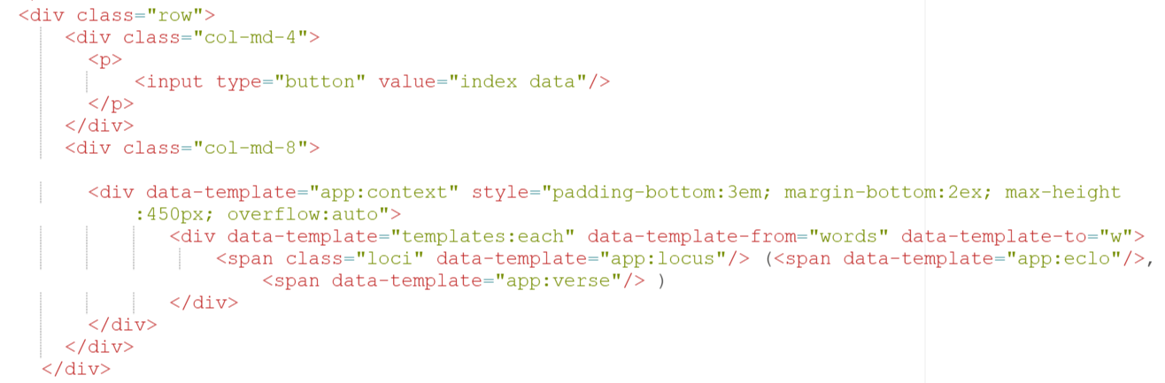
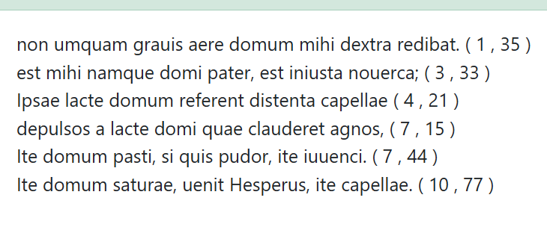

Slide 45
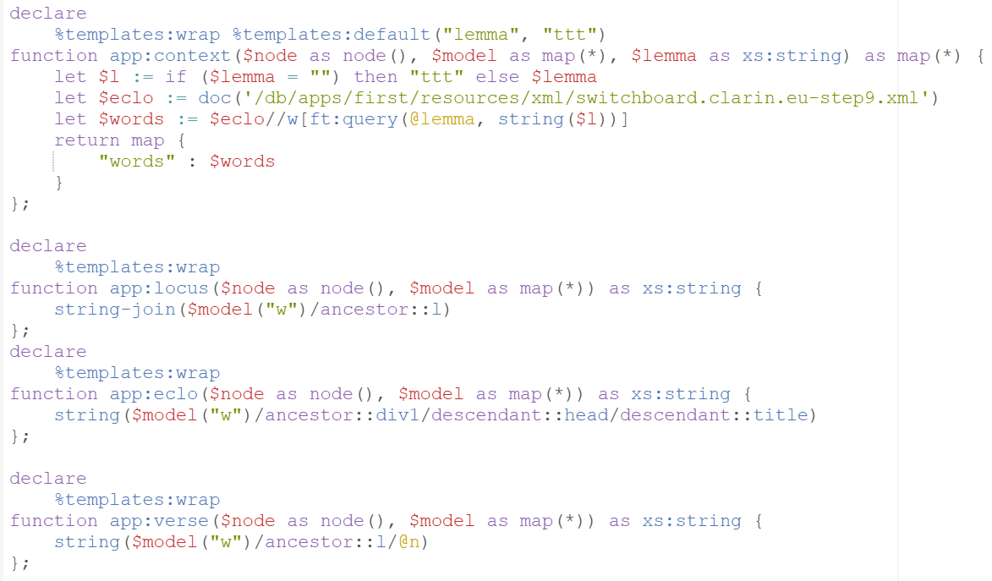

Slide 46
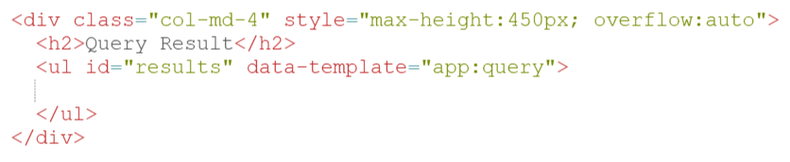
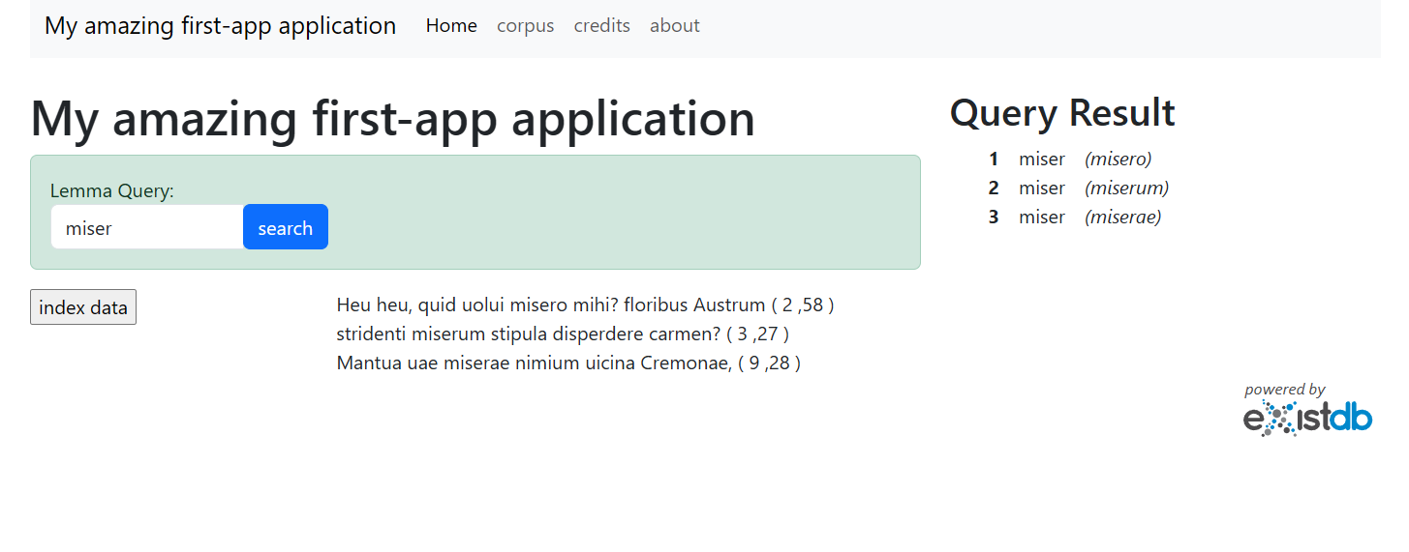

Slide 47
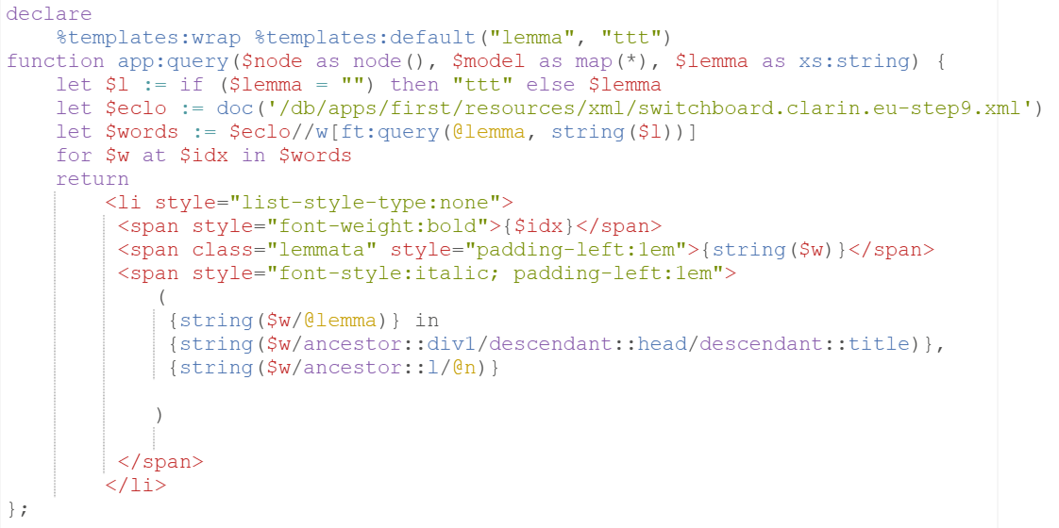

Slide 48
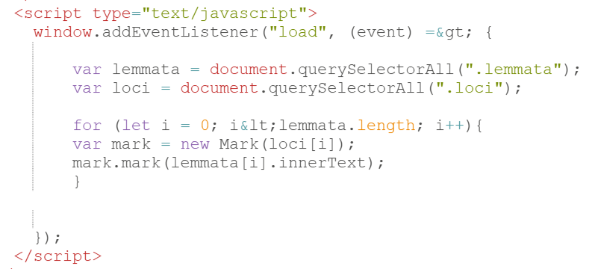

Slide 49
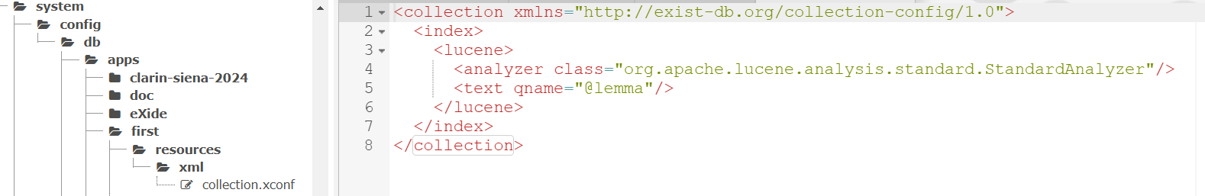
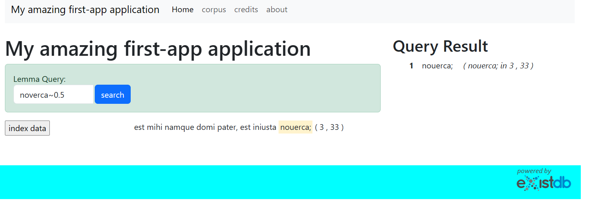

Slide 50


Slide 51

Mode: Bassani’s Postille Applet

Slide 52

Mode: Voci dall’Inferno Applet

Slide 53

What’s next

Slide 54

TEIPublisher

Slide 55

TEIPublisher - Web Component

Slide 56
Intro to eXist-db and applet XQuery
THANKS
Angelo Mario Del Grosso (ILC-CNR, Pisa)
FeDHLab

